Slide 1

Short Term Internship (Virtual)
Palo Alto Networks Certified Cybersecurity Entry-level Technician (PCCET)
September 2023 – November 2023
BY :
PAMPANA JAI KIRAN
Regd .No. 2021-2222043
BCA -Data Science – 5th Semester
UNDER THE GUIDANCE OF
Smt.U.Sahiti
Assistant Professor
Department of Computer Applications(UG)

Slide 2

SHORT-TERM INTERNSHIP
( Virtual )
Palo Alto Networks Certified Cybersecurity Entry-level Technician
(PCCET)

Slide 3
CONTENTS
EXECUTIVE SUMMARY
INTRODUCTION OF THE ORGANISATION
INTERNSHIP PART
ACTIVITY LOG FOR THE FIRST WEEK
ACTIVITY LOG FOR THE SECOND WEEK
ACTIVITY LOG FOR THE THIRD WEEK
ACTIVITY LOG FOR THE FOURTH WEEK
OUTCOMES
CONCLUSION

Slide 4
EXECUTIVE SUMMARY
The internship report shall have only a one-page executive summary. It shall include five or more Learning Objectives and Outcomes achieved, a brief description of the sector of business and intern organization and summary of all the activities done by the intern during the period.

Slide 5
INTRODUCTION OF THE ORGANISATION
Palo Alto Networks, Inc. is a global cybersecurity leader headquartered in Santa Clara, California, renowned for its advanced firewalls and cloud-based security solutions serving over 70,000 organizations worldwide, including 85 of the Fortune 100. The company, led by CEO Nikesh Arora, envisions a safer digital world through innovative disruption and steadfast execution. Its mission, to be the cybersecurity partner of choice, underscores a commitment to safeguarding our digital way of life. Interns play pivotal roles across various teams, including product development, sales, security operations, and finance, benefiting from mentorship, collaboration, and hands-on experience. The organization's policies encompass corporate governance, ethical conduct, sustainability, diversity, inclusion, and robust security measures. Structurally, the company operates under executive leadership, distinct business units, and geographic regions, driving innovation, growth, and global impact. Employee roles range from mentors providing guidance to managers overseeing performance, fostering a dynamic learning environment for interns to thrive and contribute to Palo Alto Networks' mission of securing our digital future.

Slide 6
INTERNSHIP PART
Engaging in an internship presents a valuable opportunity for learning. I diligently engage with each module provided, maintaining a positive attitude throughout. Each module typically comprises five articles, which I meticulously read, extracting and noting down essential details. I ensure attentive comprehension of every topic and actively seek clarification for any queries. Throughout the internship, I utilize technological tools such as laptops, mobile devices, and Wi-Fi to access and delve into each subject matter thoroughly.

Slide 7
ACTIVITY LOG FOR THE FIRST WEEK
Week 1:
Enrolled in the APSCHE Edu Skills virtual internship for cybersecurity.
Received foundational knowledge about cybersecurity, including its significance and common tools used for protection.

Slide 8
Day & Date | Brief description of the daily activity | Learning Outcome
Day – 1 | Received registration link from LMS Portal (To apply for internship through portal). | I applied and submitted my resume in my interested fields
Day - 2 | Enrolled at Eduskills site after applying at APSCHE LMS portal. | Enrolled at Eduskill site
Day – 3 | Received registration link to register for APSCHE- Eduskills virtual internship. | I registered for APSCHE Eduskills victual internship
Day – 4 | Received mail that I have been shortlisted for AICTE skills Palo Alto Networks Certified Cybersecurity Entry-level Technician (PCCET) virtual internship | I got to know that I have to complete the PCCET virtual internship
Day – 5 | Explained how to access LMS, How to complete my modules, How to do labs, How to accept badge, How to get certificate | I understood the process of completion of the course
Day –6 | What is Cyber security, Network security fundementals, Cyber security fundamentals, Cloud security fundamentals, Security operation fundamentals | Introduction to cyber security

Slide 9
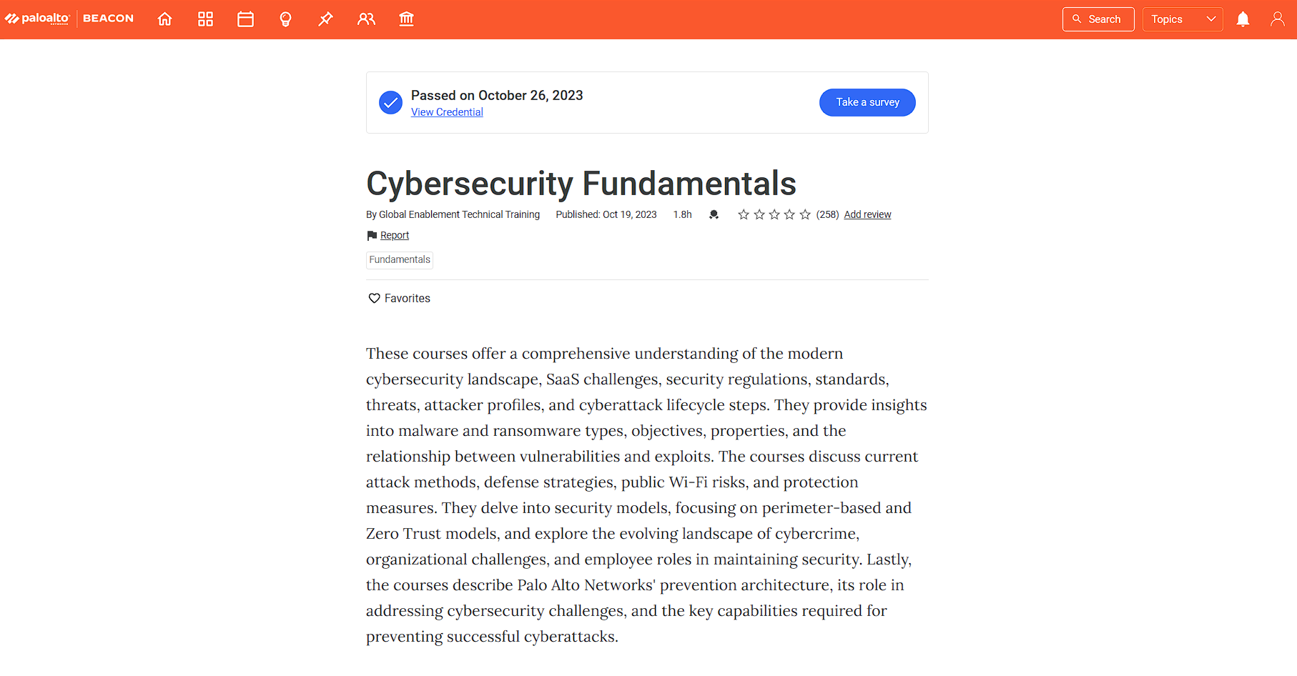

Slide 10
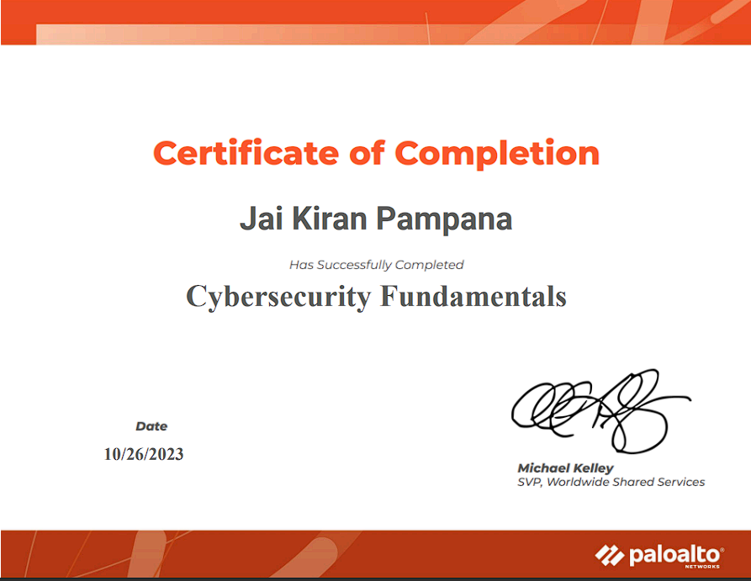

Slide 11
ACTIVITY LOG FOR THE SECOND WEEK
Week 2:
Learned about connected devices, routing, area networks, and protocols.
Explored endpoint security fundamentals and network security technologies, including packet filtering and intrusion detection systems.

Slide 12
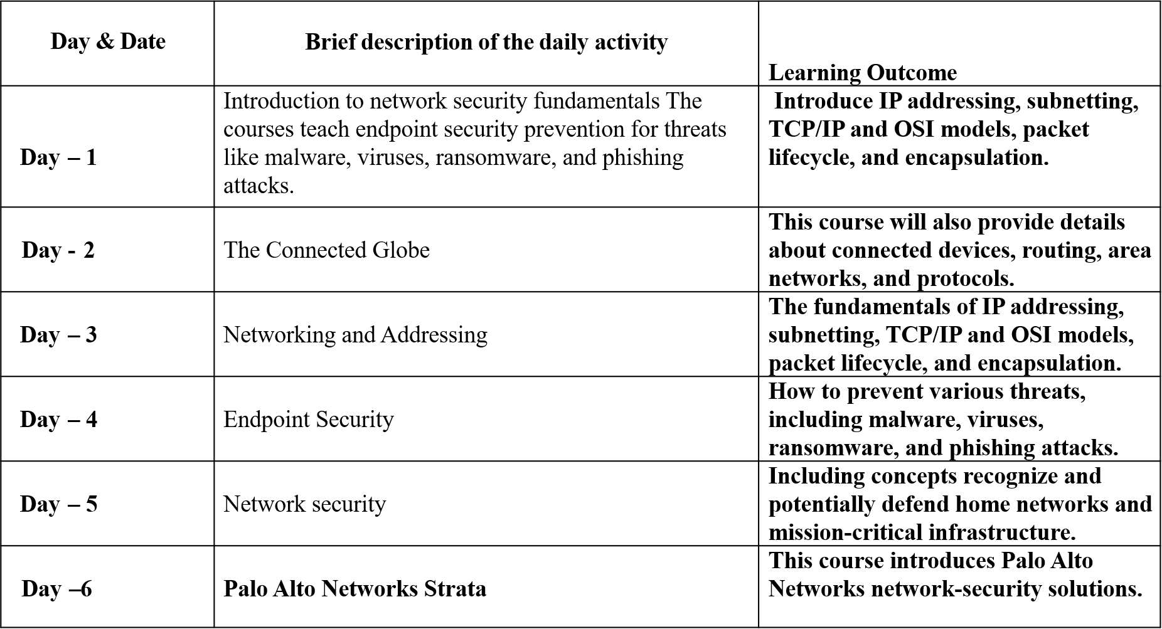

Slide 13
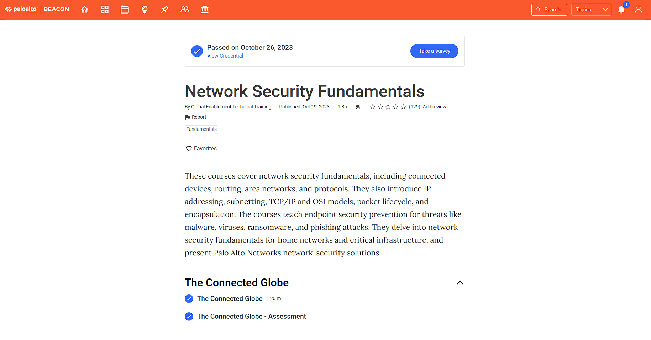

Slide 14
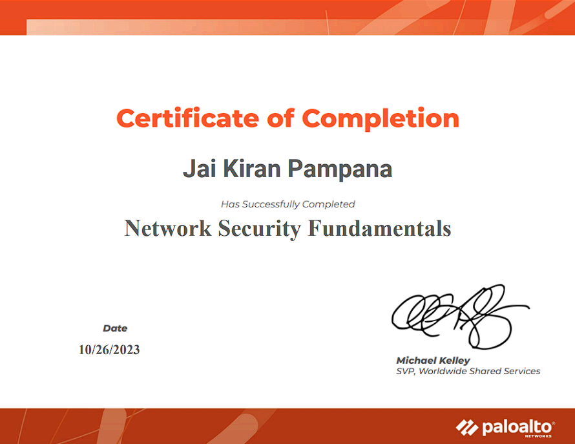

Slide 15
ACTIVITY LOG FOR THE THIRD WEEK
Week 3:
Learned about the daily life of a SecOps analyst and the six elements of security operations.
Explored endpoint protection with Cortex XDR agent and Cortex XSOAR Threat Intelligence Management (TIM) for automating threat intelligence processes

Slide 16
Day & Date | Brief description of the daily activity | Learning Outcome
Day – 1 | Introduction to Cybersecurity fundamentals They provide insights into malware and ransomware types. | Discuss current attack methods, defense strategies, public Wi-Fi risks, and protection measures.
Day - 2 | Cybersecurity Landscape | It covers various security regulations and standards, identifies different cybersecurity threats and attacker profiles.
Day – 3 | Cyberthreats | In-depth understanding of malware and ransomware, their types, objectives, and properties.
Day – 4 | Attack Techniques | Covers current cyberattack methods, defense strategies, public Wi-Fi network risks, and protection measures.
Day – 5 | Security Models | In-depth understanding of security models, focusing on perimeter-based and Zero Trust security models.
Day –6 | Security Operating Platform | Describes the evolving landscape of cybercrime, the challenges faced by organizations

Slide 17
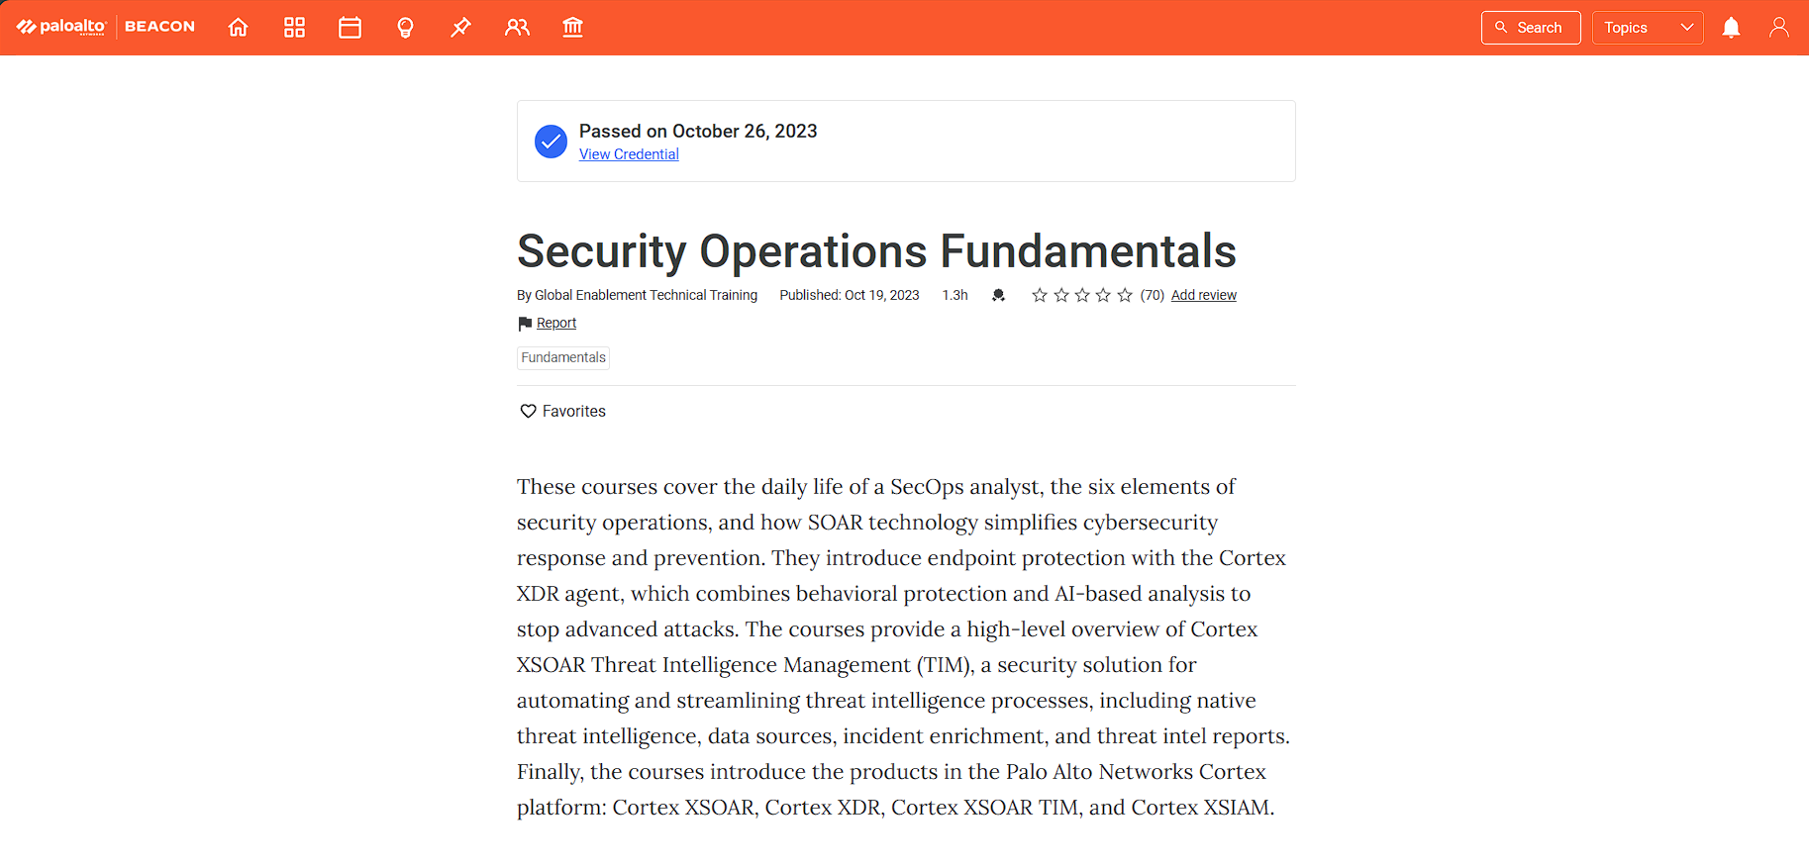

Slide 18
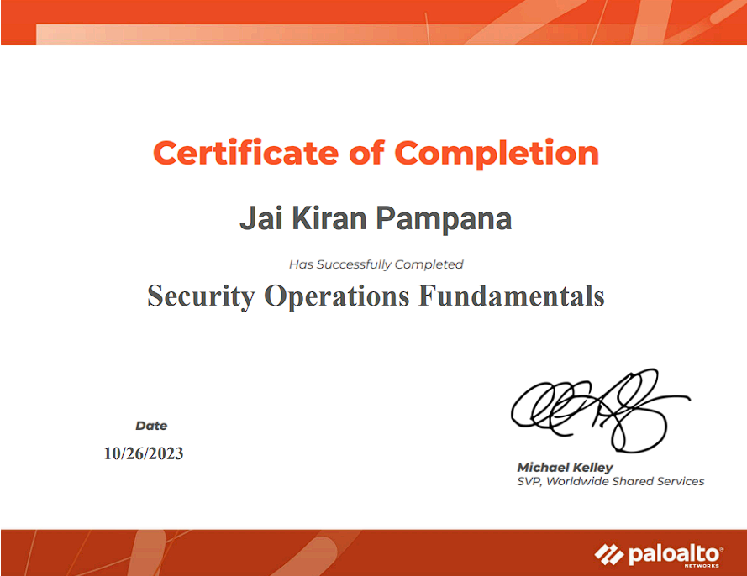

Slide 19
ACTIVITY LOG FOR THE FOURTH WEEK
Week 4:
Foundation of Fundamental’s of Cloud Security and Its operation’s
Explored the modern cybersecurity landscape, including malware types, attack methods, and defense strategies.

Slide 20
Day & Date | Brief description of the daily activity | Learning Outcome
Day – 1 | Introduction to Cloud security fundamentals They explain how cloud-native application protection platforms (CNAPP). | Cover the core technologies used in cloud computing, such as virtual machines and containers, development operations teams, and the CI/CD pipeline.
Day - 2 | Fundamentals of Cloud Security: Cloud Native Technologies | This course describes the core technologies that are used in cloud computing, such as virtual machines and containers.
Day – 3 | Fundamentals of Cloud Security: Cloud Computing Overview | Overview of cloud computing including cloud computing models, shared responsibility, best practices, and hybrid cloud computing.
Day – 4 | Cloud Security Operations | Describes the models and processes by which organizations use cloud technologies.
Day – 5 | Cloud Application Protection Platform | How CNAPP provide comprehensive protection with integrated security and complince capabilities
Day –6 | Prisma Cloud | How the Prisma Cloud platform detects security risks using a cloud native application protection platform.

Slide 21
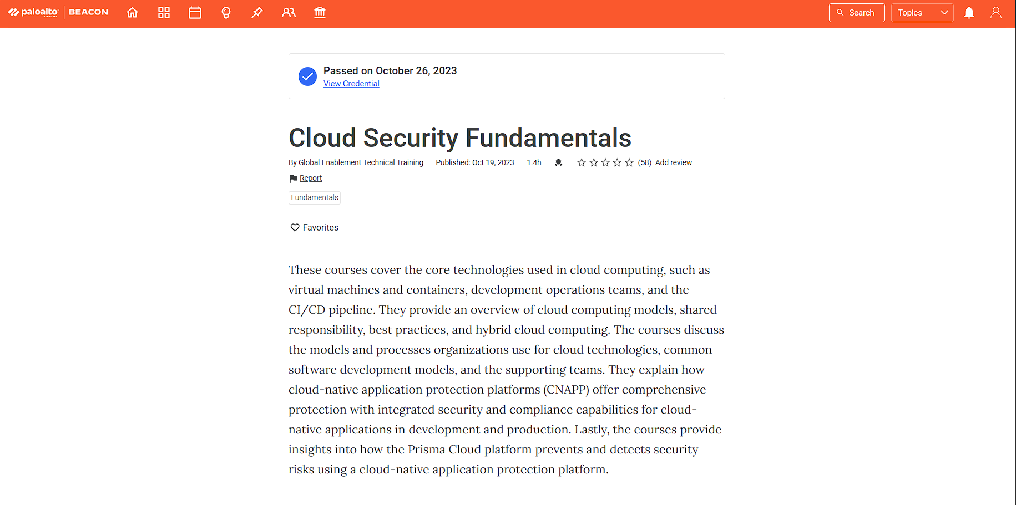

Slide 22
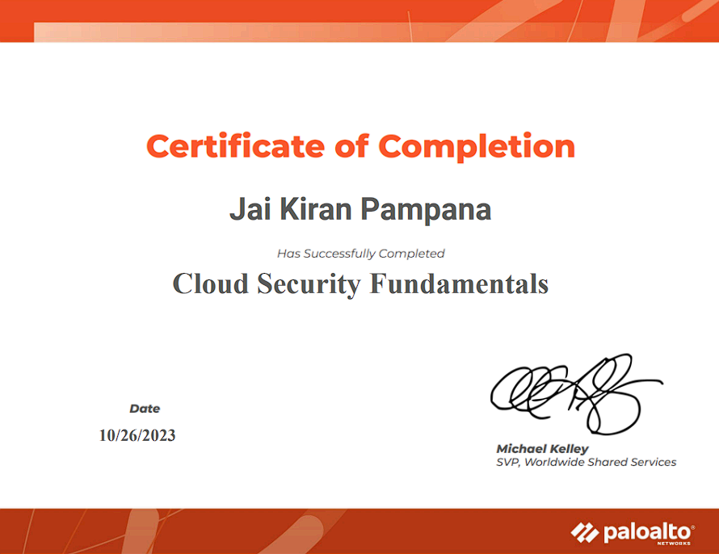

Slide 23
CONCLUSION
In conclusion, the short-term internship with Palo Alto Networks, facilitated by Edu-Skills Foundation, has been a transformative journey marked by significant growth in both technical and managerial skills. Through hands-on experience, I have acquired expertise in next-generation cybersecurity technologies, honed my leadership abilities, and developed a commitment to continuous learning. This experience has not only enhanced my understanding of the cybersecurity landscape but has also equipped me with the necessary tools to tackle emerging challenges in the field. I am grateful for the opportunity to be part of such a enriching program, and I look forward to applying the knowledge and skills gained to make meaningful contributions in the cybersecurity domain.

Slide 24

Thank You

